Slide 1

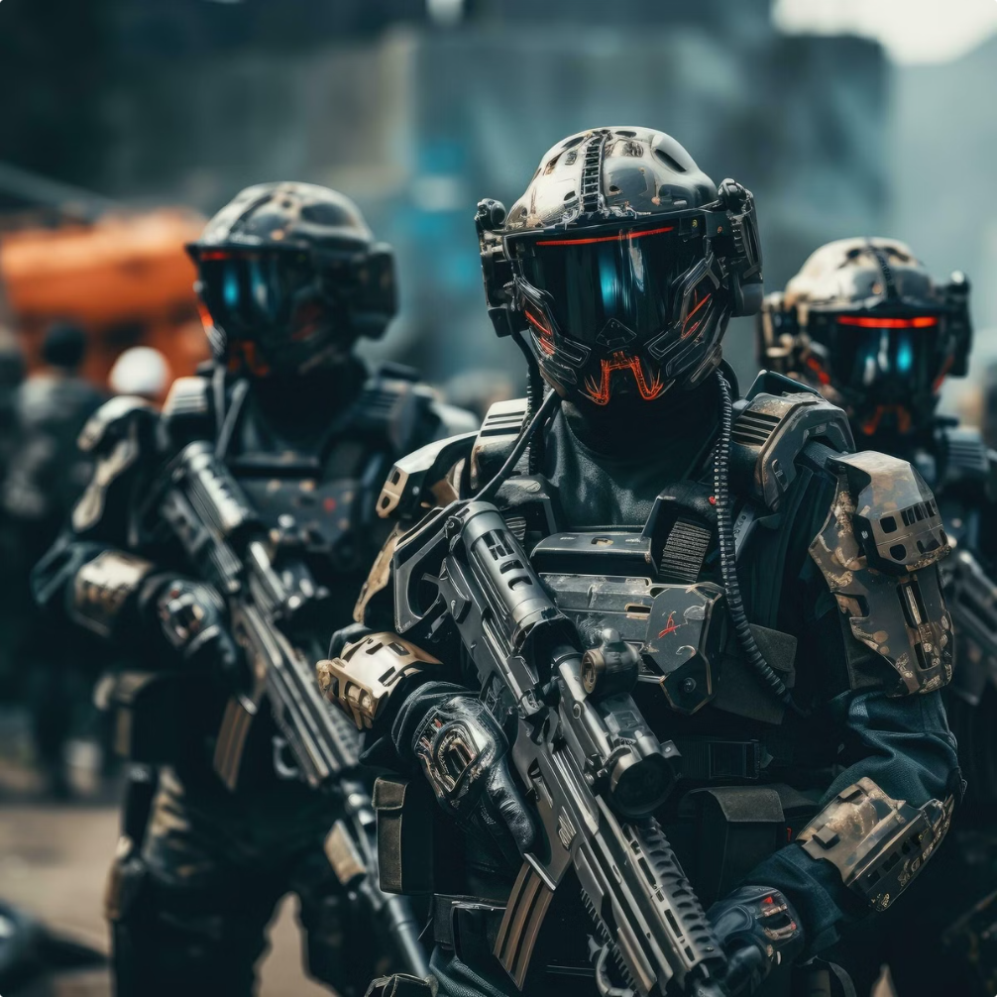
Defence Technology
Defence technology encompasses the development and application of advanced technologies for military purposes. It is an ever-evolving field driven by innovation and the need to maintain strategic advantage.
By
Nehant Sawarkar
Atharva Mishra

Slide 2
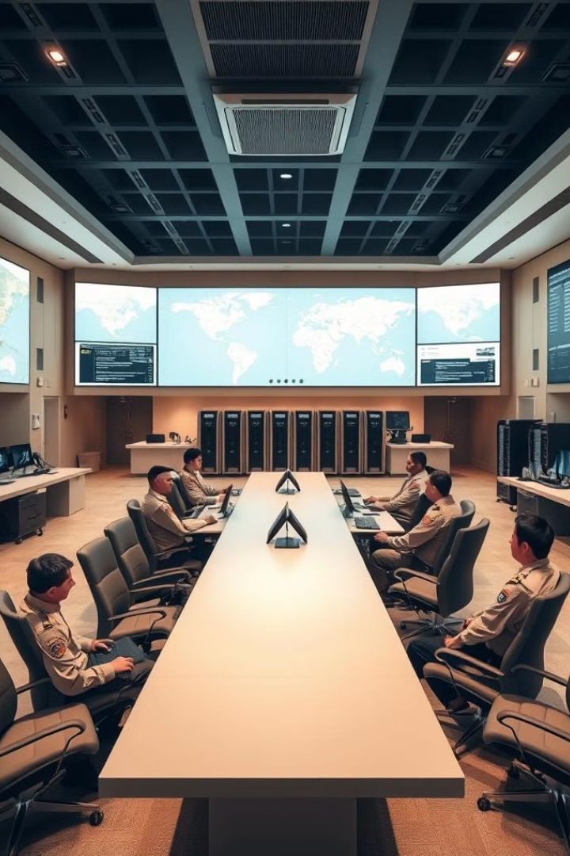
Content
1
Evolution of Defence
technology
2
History of Defence
technology
3
Artificial Intelligence
and Autonomous
System
Advancements in Aerospace and Propulsion
Directed Energy Weapons and Laser Technology
Conclusion and Future Outlook
Innovation Idea from overall presentation
4
Cybersecurity and
Information Warfare
5
6
7
8

Slide 3

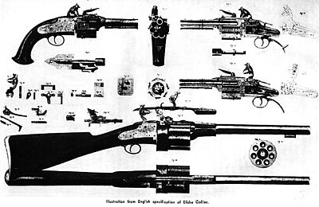
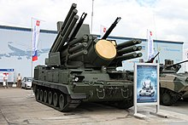
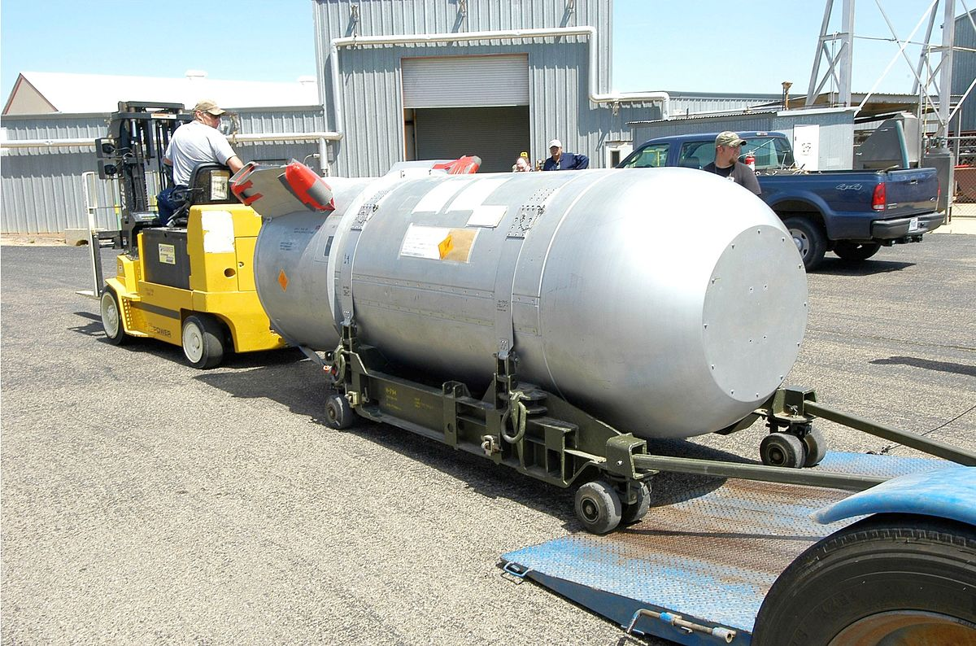
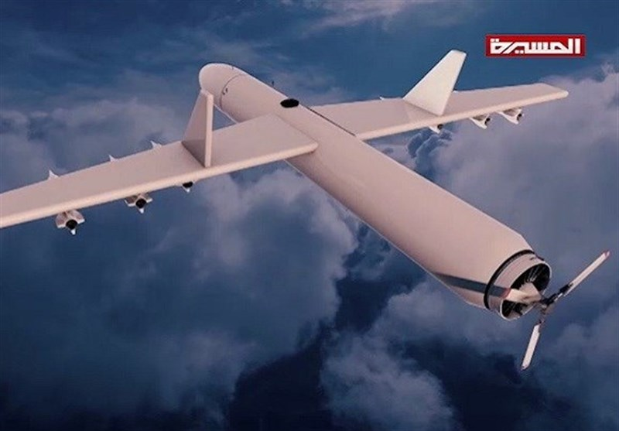
Evolution of Defence technology
1
Early Weapons
From spears and bows to gunpowder-based firearms.
2
Industrial Revolution
Mass production of weapons and introduction of steam power.
3
World Wars
Advances in aviation, tank warfare, and nuclear weapons.
4
Cold War
Focus on nuclear deterrence and space race.
5
Modern Era
Emergence of advanced technology like drones, AI, and cyberwarfare and data race.

Slide 4






History of Defence Technology
Ancient Warfare
Early weapons included spears, bows, and swords. Warfare was primarily focused on hand-to-hand combat.
Gunpowder Era
The invention of gunpowder revolutionized warfare. Cannons and firearms became dominant weapons.
Industrial Revolution
Mass production of weapons and introduction of steam power led to larger armies and more powerful weapons.
World Wars
Advances in aviation, tank warfare, and the development of nuclear weapons marked a turning point in warfare.
Cold War
Focus shifted to nuclear deterrence and space race, with both sides developing advanced technologies.
Modern Era
Emergence of advanced technologies like drones, AI, and cyberwarfare continues to reshape the landscape of warfare.

Slide 5
Artificial Intelligence and Autonomous Systems
Autonomous Weapons
AI-powered Decision Making
Automated Surveillance
Robots capable of selecting and engaging targets without human intervention.
AI systems analyze vast amounts of data to support strategic decisions.
AI algorithms analyze data from sensors to detect threats and track targets.

Slide 6





Cybersecurity and Information Warfare
Cyberattacks
Hacking and disruption of critical infrastructure and networks.
Information Warfare
Spreading propaganda, manipulating public opinion, and undermining trust.
Cyberdefense
Protecting networks, data, and systems from cyber threats.

Slide 7
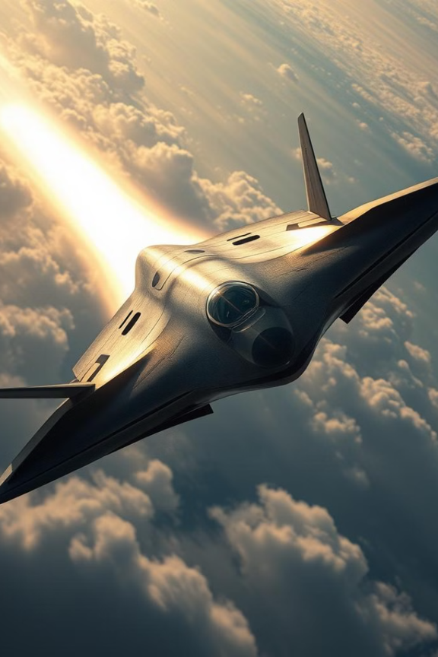




Advancements in Aerospace and Propulsion
Hypersonic Weapons
Unmanned Aerial Vehicles (UAVs)
Highly maneuverable missiles that travel at speeds exceeding Mach 5.
Remotely controlled aircraft used for reconnaissance, surveillance, and strike missions.
Space-Based Systems
Next-Generation Fighters
Satellites provide real-time intelligence, communications, and navigation capabilities.
Advanced fighter jets with enhanced stealth, maneuverability, and sensor capabilities.

Slide 8
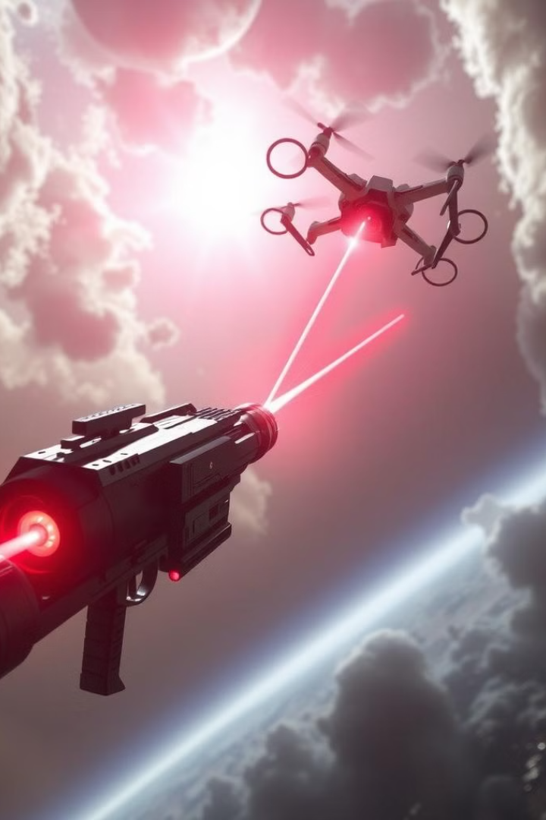
Directed Energy Weapons and Laser Technology
Type
Description
Laser Weapons
Concentrate energy beams to damage targets.
High-Power Microwaves
Disrupt electronic systems and equipment.
Particle Beam Weapons
Use high-energy particles to damage or destroy targets.

Slide 9
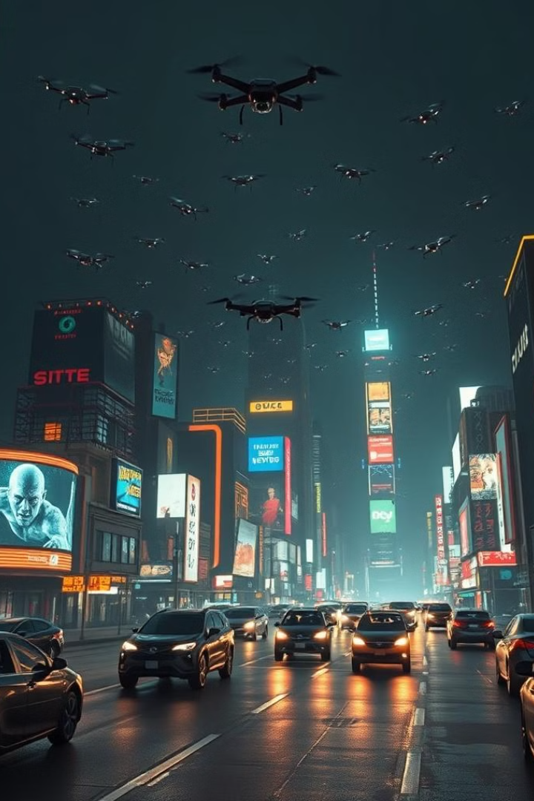
Conclusion and Future Outlook
Defence technology is constantly evolving to address emerging threats and maintain national security. Future advancements will likely include further integration of AI, advanced robotics, and space-based systems.

